Slide 1
CS 205
Artificial Intelligence

Slide 2
Clustering: why bother?
You tell me... why would we want to cluster data?
group similar items
...what else

Slide 3
K-Means
k = no. clusters
General algorithm:
Pick k-centroid points at random.
Assign all points to nearest centroid.
Recalculate k-centroids.
Repeat 2-3 until convergence.

Slide 4
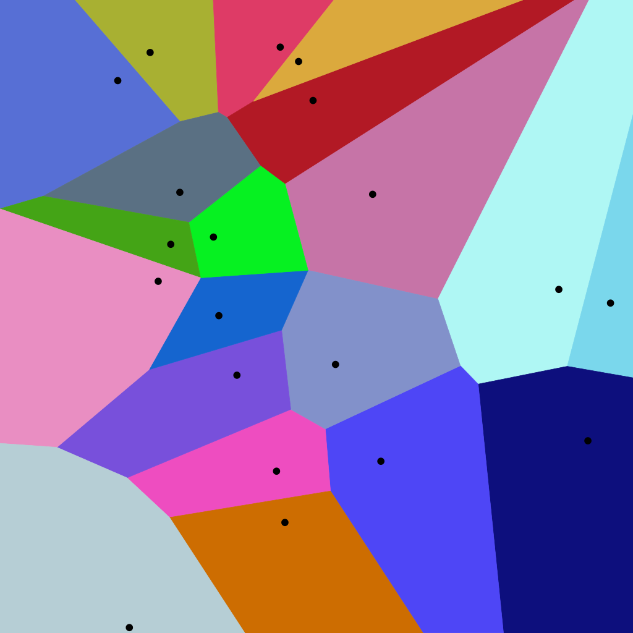
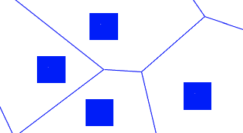
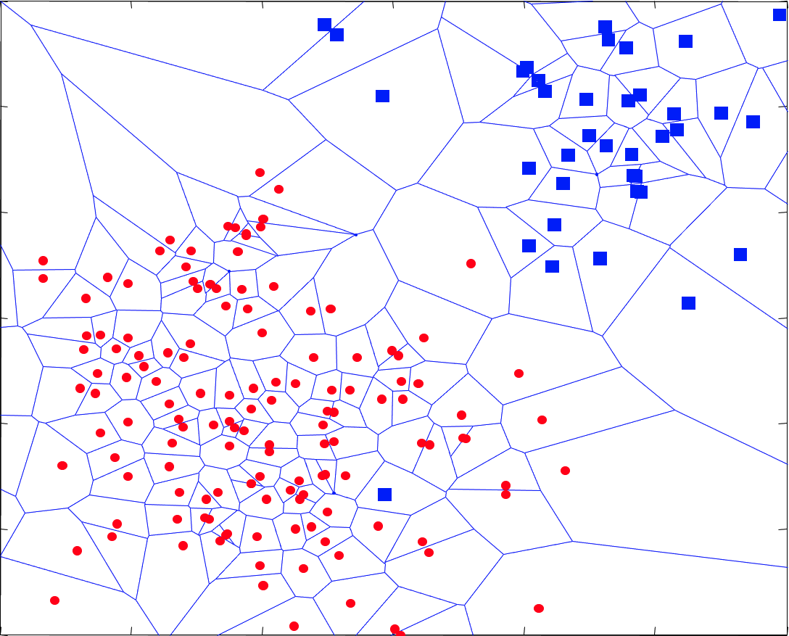
Voronoi Diagram
a partition of a plane into regions close to each of a given set of objects

Slide 5
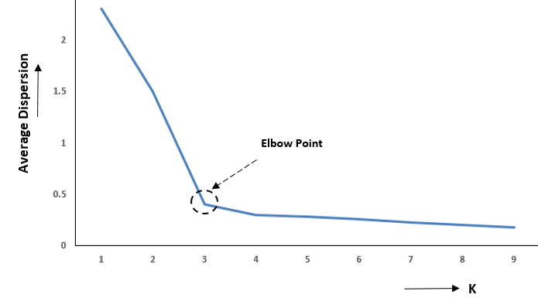
How to determine k?
distortion, dispersion, variance, WCCS ... "objective function" Within Cluster Sum of Squares: sum of the squared distance between each member of the cluster and its centroid. The "elbow" method.
This is not the ONLY way!

Slide 6
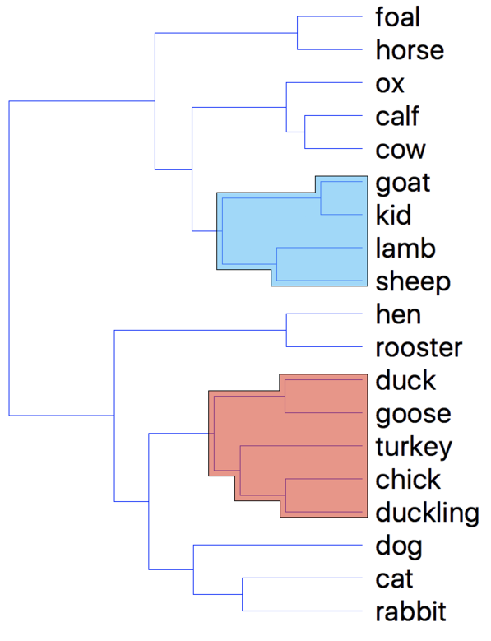
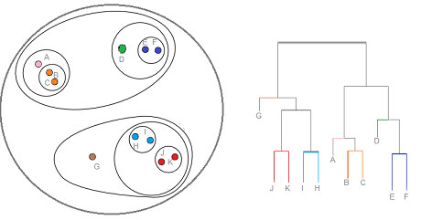
Hierarchical Clustering
Agglomerative (vs. Divisive)
General algorithm:
Every point starts as its own cluster.
Pair nearest clusters.
Repeat 2 until convergence.

Slide 7
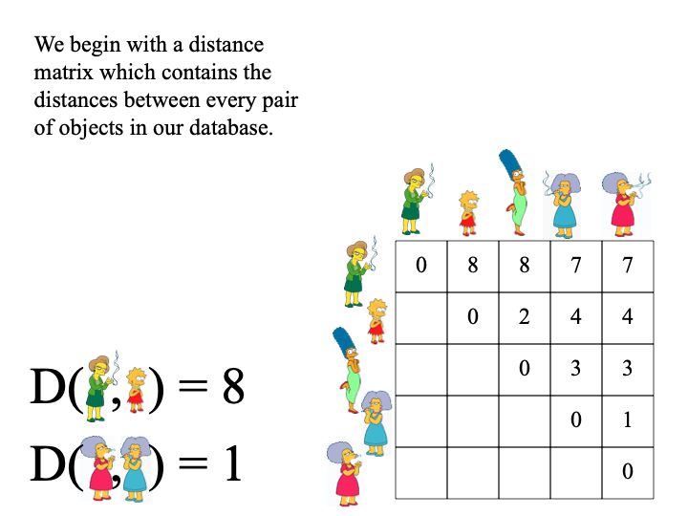
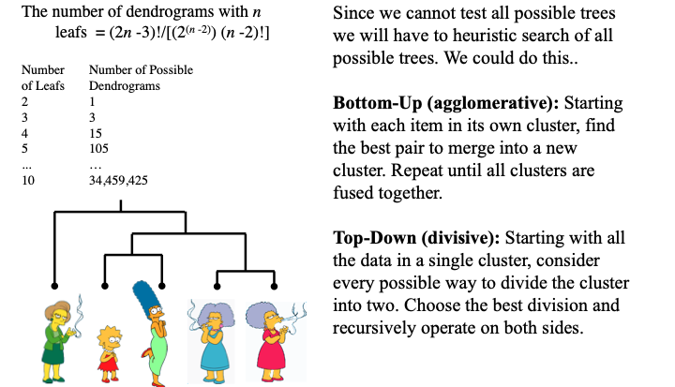
Hierarchical Clustering

Slide 8

Discuss
Two tasks:
Is the K-means algorithm provided optimal?
What is the computational complexity of the provided agglomerative clustering algorithm?

Slide 9
Other approaches
DBSCAN — density-based spatial clustering of applications with noise
test of time award
one of the 8 most downloaded articles
PCA — principal components analysis
an unsupervised machine learning technique that attempts to derive a set of low-dimensional set of features from a much larger set while still preserving as much variance as possible
Topic Modelling — latent Dirichlet allocation

Slide 10
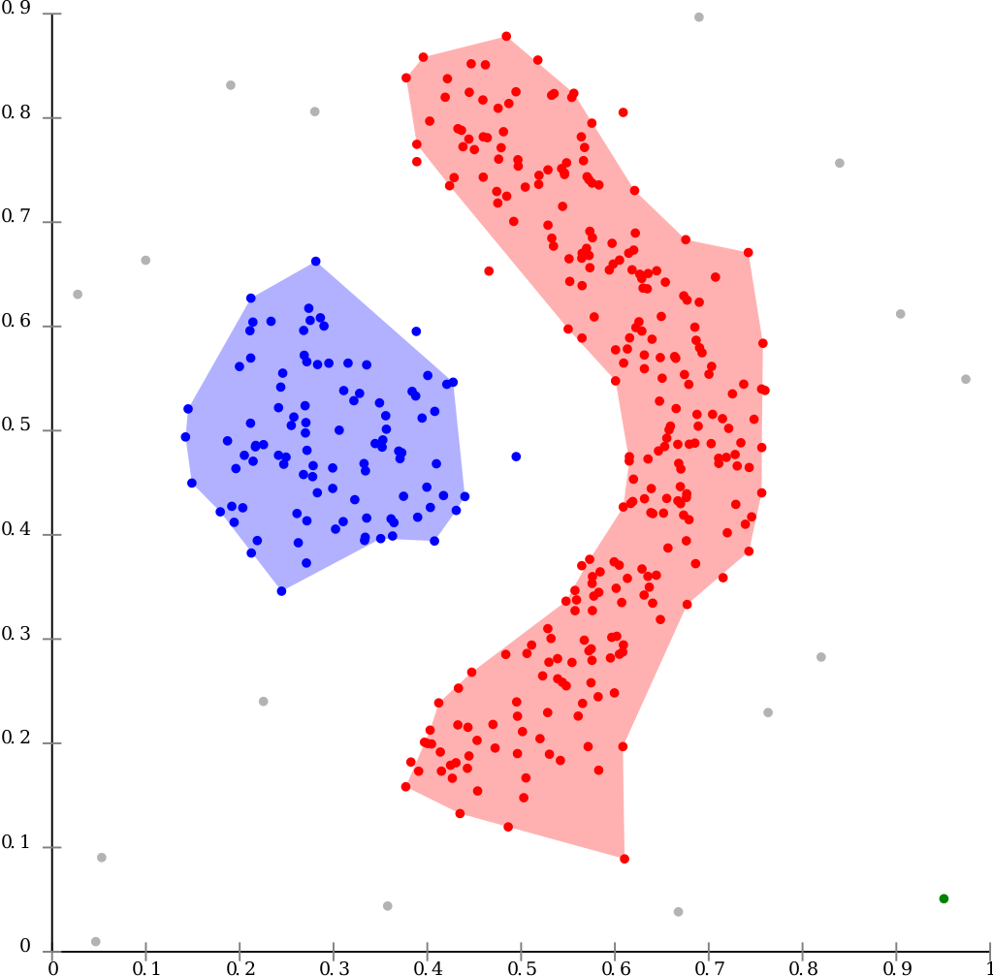
DBSCAN
K-means would not find these...
Find the points in the ε-neighborhood of every point, and identify the core points with more than minPts neighbors.
Find the connected components of core points on the neighbor graph, ignoring all non-core points.
Assign each non-core point to a nearby cluster if the cluster is an ε-neighbor, otherwise assign it to noise.

Slide 11
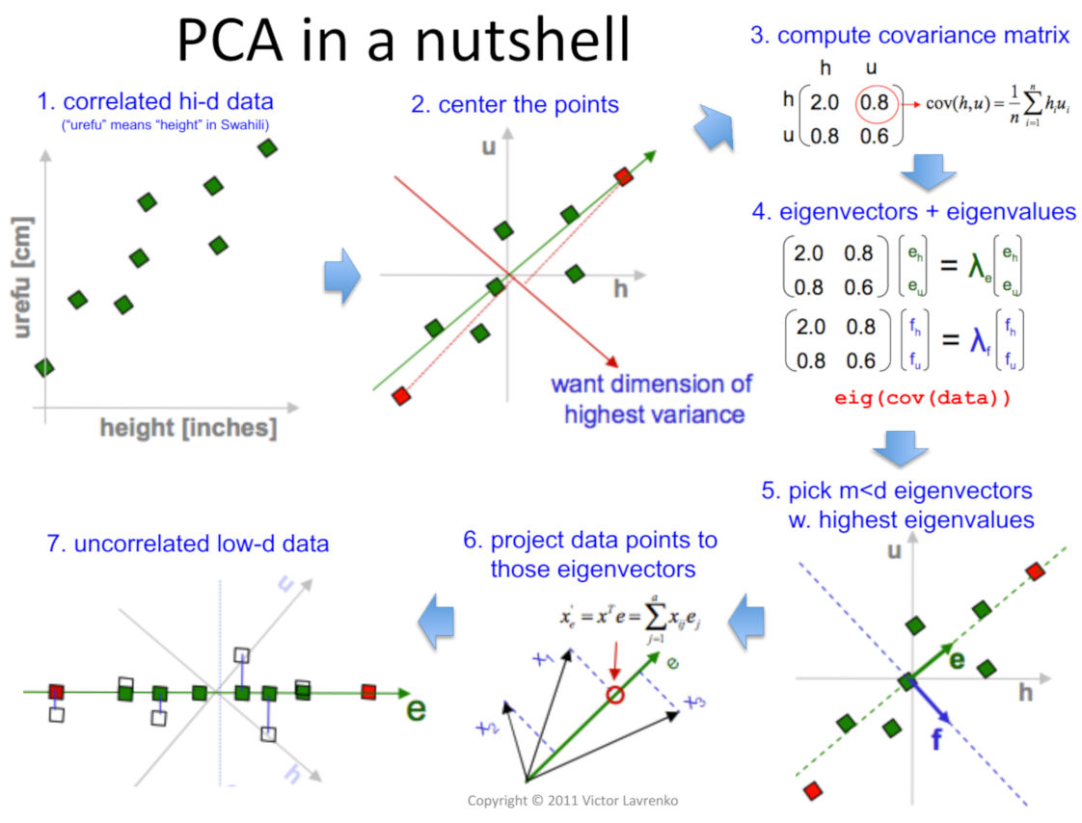
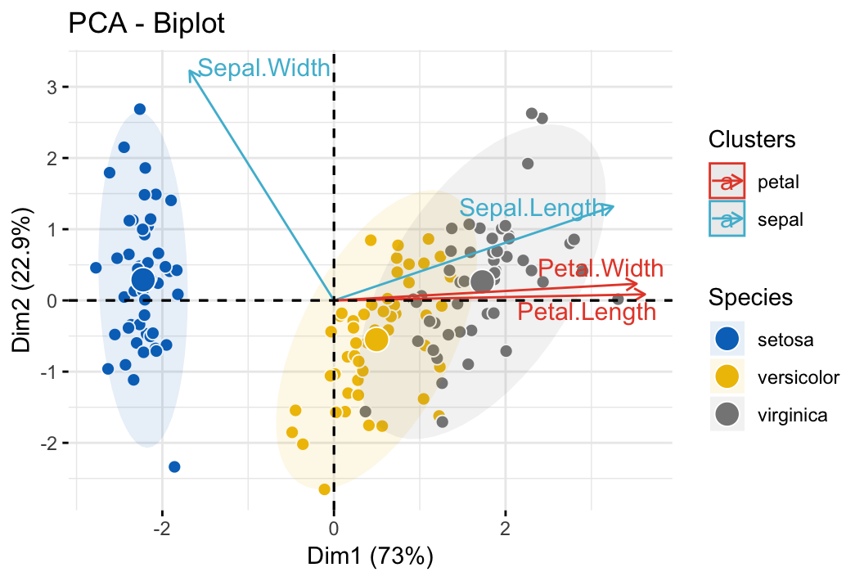
PCA
matrix transformations to lower dimensional space

Slide 12
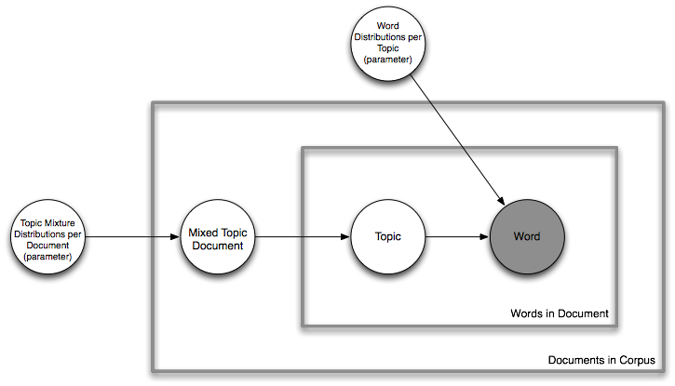
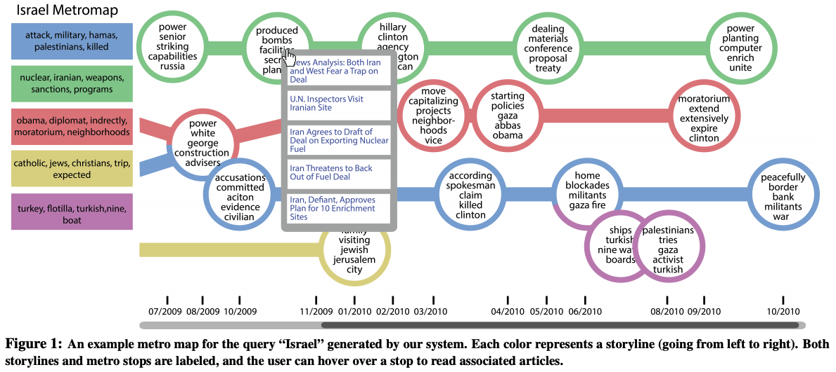
Topic Modelling / LDA
A generative modelling technique in NLP.
Assumption: topics are latent (unobservable) features responsible for generating words on the page, which we do observe.
Can we learn those topics?
Shahaf et al. "Information Cartography..." KDD 2013

Slide 13
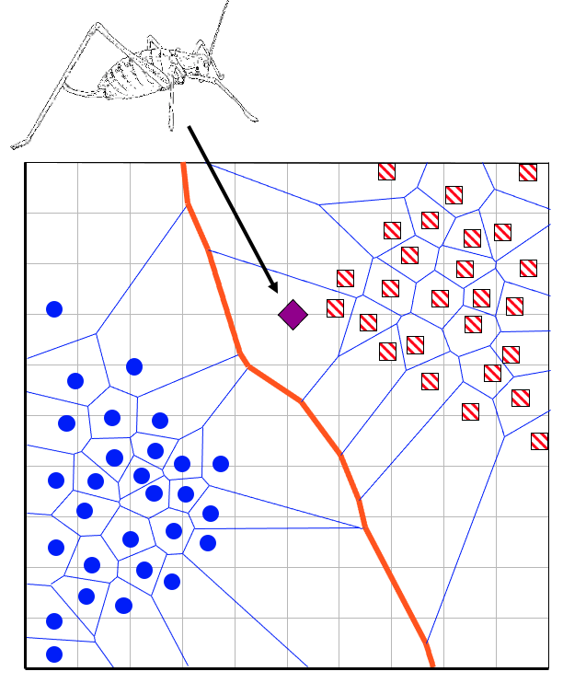
Next time... Classification
KNN — nearest neighbors
Naive Bayes
Logistic Regression
Decision Trees

